Slide 1
React Router & Redux
www.devbridge.com
Sourcery Academy

Slide 2
Agenda
React Router
What it is?
How to use it?
App update – settings implementation
Redux
Lifecycle
How it changes react data flow
Plan to refactoring app

Slide 3
Why routing?
Single page applications
Have many different views and sections
Usually have a centralized panel for navigation
Example – Facebook
Post stream
Messenger
Settings

Slide 4
React-router
Keeps your UI in sync with the URL
Use location path for rendering different components
Lazy loading
History navigation

Slide 5
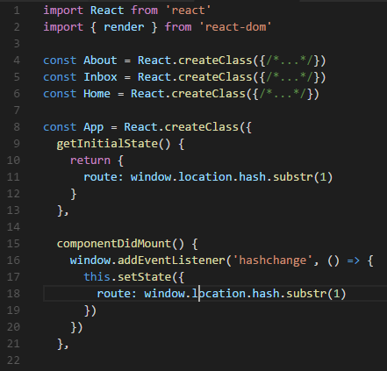
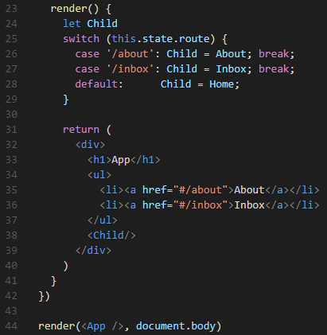
Navigation – vanilla react

Slide 6
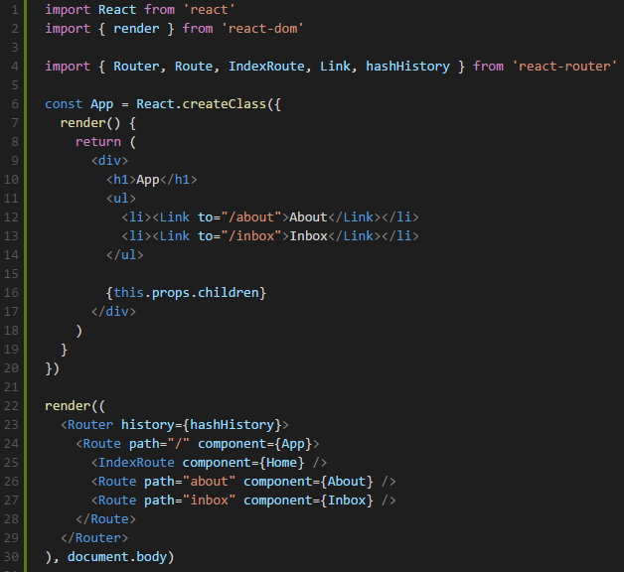
Navigation – React Router

Slide 7
How it works?
localhost:8080/#/app
window.addEventListener('hashchange')
Router check <Routes> tree for an component with path=‘app’
{this.props.children} – changes
New components are rendered
History is updated with new page view

Slide 8
<Router>
Primary component of React Router. It keeps your UI and the URL in sync.
Properties
History
hashHistory
browserHistory – uses HTML5 window.history
Notes:
Routes - container for routes – passes them information from whatever route mechanism is used.
Router - maps components to routes and triggers their rendering
Link – component that redirects you to a specified URL without refreshing the page
this.props.children – property, to which the resolved component is stored in for rendering

Slide 9
<Route>
Used to declaratively map routes to your application's component hierarchy
Props
Path – location pattern
‘user/:id’
Component – component name
{this.props.children}
components - {header: MainHeader, sidebar: UserSideBar}
{this.props.header}
{this.props.sidebar}
Notes:
This.props.children - property that injects a component matched by pattern

Slide 10
<Link>
Allow users to navigate around your application
Render a fully accessible anchor tag with the proper href to
Props
to
pathname
query - this.props.location.query
hash - this.props.location.hash
state - this.props.location.state
activeStyle

Slide 11
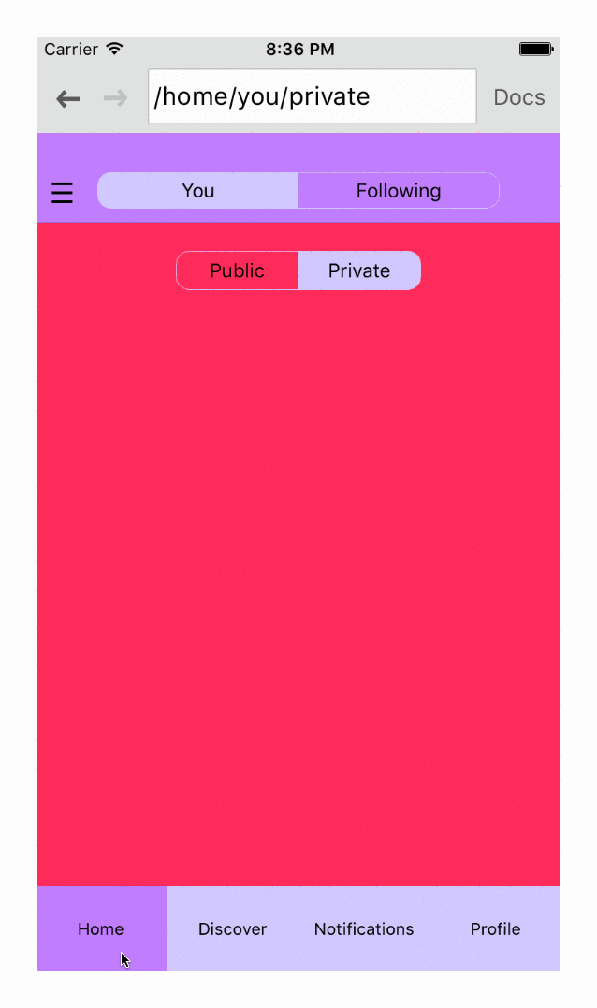
Example

Slide 12
Summary
Allows to use routes for rendering different components
Allows to define routes declaratively
Easily configurable to either use browser history API or the hash URLs
Saves time, no code for manual routing required
Provides lazy Loading

Slide 13
Let’s code

Slide 14
Task definition
Add settings page for Todolist app
Provide a way to set a background of an app

Slide 15
Coding steps
Let’s implement a settings panel for the todo list app
Steps:
Init the project
Set up a <Router> with <Routes>
Set {this.props.children} entry point in a desired location
Test by directly editing URL
Add <Link> for navigating through UI

Slide 16
What is flux?
Flux is an architecture that Facebook uses internally when working with React

Slide 17
What is redux?
Immutable state container for JS apps
Enchanced flux architecture
Can be used with angular or other frameworks

Slide 18
Why redux?
Provides a centralized place to store data
Provides a way to inject it to given components
No need to multiple props passing
Hot loading and time travel

Slide 19
TodoApp without redux
TodoApp needs to be a parent container for storing state
Issues with passing to {this.props.children}
No convenient way to pass to parent state changes

Slide 20
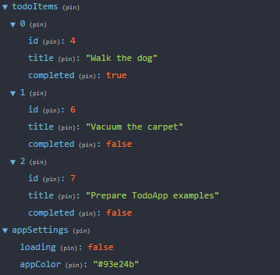
Store
Holds the whole state tree of your application.
The only way to change the state inside it is to dispatch an action on it
store.dispatch()
store.subscribe()
store.getState()

Slide 21
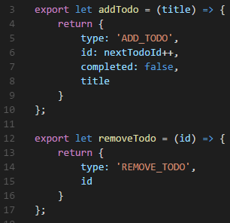
Actions creators
Functions that create actions
Action is a payload of information
TYPE
PAYLOAD
store.dispatch(actionCreator(newName))

Slide 22
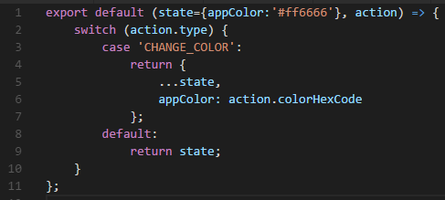
Reducers
Reducers are pure functions
Takes current state and returns new one
All reducers receives an action
After all reducers are finished subscribed components receive update

Slide 23
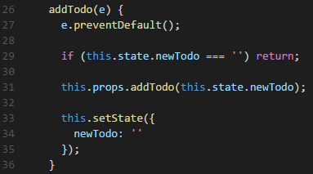
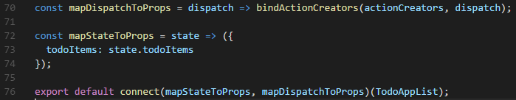
Components
React component triggers actions and renders state
Action creators and state are injected
connect() – higher order function
mapDispatchToProps
mapStateToProps

Slide 24
Redux flow

Slide 25
Let’s code

Slide 26
Implementing redux
Add <Provider> on top of <Routes>
Create store and bind it with reducer
Implement reducer base
Create actions
Connect components to state and dispatch
Replace component calls to store

Slide 27
Thank You
www.devbridge.com
Sourcery Academy

